Slide 1
Class Activity

Slide 2
Class activity
Go to https://t-tweak.gershon.info/docs and look at the substring API
Suggest tests in this form
A test is defined as: <string> <start> <end>
Examples:
“hello world” 5 7
“very looooooooooooooooooooong string” 1 1
“negative test example” 8 4
10 Minutes
Notes:
Stop after ~10 minutes to discuss

Slide 3
Class discussion
What type of tests were suggested?
Notes:
Stop after ~10 minutes to discuss

Slide 4
Class activity (2)
What tests should be run on a REST API?
Ask your favorite AI
Ask another AI
10 Minutes
Notes:
Stop after ~10 minutes to discuss

Slide 5
Class Activity

Slide 6
Class activity (1)
Download get_a_room.exe from Moodle
Via this application you can find out how many hotels can accommodate a specific reservation
The hotel database has 100 hotels
The database is updated for dates between
1/10/26 and 30/09/28
Example:
C:\> get_a_room.exe 6/12/26 17/12/26 --single 2 --double 1
Number of hotels that meet your needs: 11
Notes:
Stop after ~10 minutes to discuss

Slide 7
Class activity (2)
Goal:
Write 3 test cases to test the output to this form
10 minutes
Notes:
Stop after ~10 minutes to discuss

Slide 8
Class activity (3) – Game rules
You can execute the tool as many times as you want with related inputs
Your goal: Prove that the black-box system contains a bug by finding a logical contradiction between two or more test runs
Be the first team to uncover a bug!
30 minutes
Hint 1: Auto-generated tests, implementing rules 1 & 2
Hint 2: Tell AI to write the test script
Motivation: There are 3 bugs in this code!

Slide 9
Decision Table Testing
Test Design Techniques

Slide 10
Decision Table
A Table showing:
Combinations of inputs and/or stimuli (causes)
The associated outputs and/or actions (effects)
Used to design test-cases

Slide 11
When to use Decision Tables?
To test system requirements that contain logic
Nested If-Then-Else
Switch structures
Business logic
The output is dependent on the value of several input fields
System with a lot of rules

Slide 12
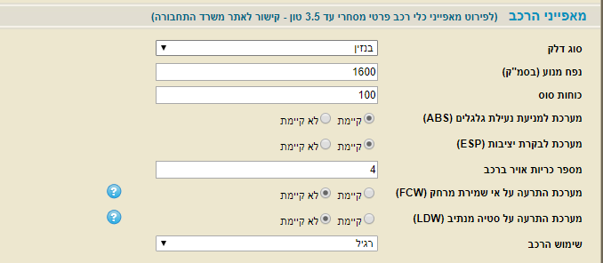
Exercise

Slide 13
כללי הנחות
אם אין אמצעי בטיחות, אין הנחה.
אם יש ABS ו\או ESP, יש הנחה של 15% על דמי הביטוח
אם יש FCW יש הנחה של 10% על דמי הביטוח
אם יש LDW יש הנחה של 20% על דמי הביטוח
אם יש FCW, ההנחה על ABS ו – ESP מתבטלות
אם יש LDW, ההנחה עלFCW מתבטלת (אבל עדיין כלל 5 תופס)
ההנחות מצטרפות אחת לשניה – אלא אם הכללים מונעים זאת.

Slide 14
כללי הנחות
אם אין אמצעי בטיחות, אין הנחה.
אם יש ABS ו\או ESP, יש הנחה של 15% על דמי הביטוח
אם יש FCW יש הנחה של 10% על דמי הביטוח
אם יש LDW יש הנחה של 20% על דמי הביטוח
אם יש FCW, ההנחה על ABS ו – ESP מתבטלות
אם יש LDW, ההנחה עלFCW מתבטלת (אבל עדיין כלל 5 תופס)
ההנחות מצטרפות אחת לשניה – אלא אם הכללים מונעים זאת.
Condition | T1 | T2 | T3 | T4 | T5 | T6 | T7 | T8
ABS_ | N | N | N | N | N | N | N | N
ESP_ | N | N | N | N | Y | Y | Y | Y
FCW_ | N | N | Y | Y | N | N | Y | Y
LDW_ | N | Y | N | Y | N | Y | N | Y
Action
Discount | 0 | 20 | 10 | 20 | 15 | 35 | 10 | 20

Slide 15
כללי הנחות
אם אין אמצעי בטיחות, אין הנחה.
אם יש ABS ו\או ESP, יש הנחה של 15% על דמי הביטוח
אם יש FCW יש הנחה של 10% על דמי הביטוח
אם יש LDW יש הנחה של 20% על דמי הביטוח
אם יש FCW, ההנחה על ABS ו – ESP מתבטלות
אם יש LDW, ההנחה עלFCW מתבטלת (אבל עדיין כלל 5 תופס)
ההנחות מצטרפות אחת לשניה – אלא אם הכללים מונעים זאת.
Condition | T9 | T10 | T11 | T12 | T13 | T14 | T15 | T16
ABS_ | Y | Y | Y | Y | Y | Y | Y | Y
ESP_ | N | N | N | N | Y | Y | Y | Y
FCW_ | N | N | Y | Y | N | N | Y | Y
LDW_ | N | Y | N | Y | N | Y | N | Y
Action
Discount | 15 | 35 | 10 | 20 | 15 | 35 | 10 | 20

Slide 16
כללי הנחות
Condition | T1 | T2 | T3 | T4 | T5 | T6 | T7 | T8
ABS_ | N | N | N | N | N | N | N | N
ESP_ | N | N | N | N | Y | Y | Y | Y
FCW_ | N | N | Y | Y | N | N | Y | Y
LDW_ | N | Y | N | Y | N | Y | N | Y
Action
Discount | 0 | 20 | 10 | 20 | 15 | 35 | 10 | 20
Condition | T9 | T10 | T11 | T12 | T13 | T14 | T15 | T16
ABS_ | Y | Y | Y | Y | Y | Y | Y | Y
ESP_ | N | N | N | N | Y | Y | Y | Y
FCW_ | N | N | Y | Y | N | N | Y | Y
LDW_ | N | Y | N | Y | N | Y | N | Y
Action
Discount | 15 | 35 | 10 | 20 | 15 | 35 | 10 | 20

Slide 17
כללי הנחות
Condition | T1 | T2-4 | T3-7-11-15 | T4 | T5-13 | T6 | T7 | T8
ABS_ | N | N | ~ | N | ~ | N | N | N
ESP_ | N | N | ~ | N | Y | Y | Y | Y
FCW_ | N | ~ | Y | Y | N | N | Y | Y
LDW_ | N | Y | N | Y | N | Y | N | Y
Action
Discount | 0 | 20 | 10 | 20 | 15 | 35 | 10 | 20
Condition | T9-13 | T10 | T11 | T12 | T13 | T14 | T15 | T16
ABS_ | Y | Y | Y | Y | Y | Y | Y | Y
ESP_ | ~ | N | N | N | Y | Y | Y | Y
FCW_ | N | N | Y | Y | N | N | Y | Y
LDW_ | N | Y | N | Y | N | Y | N | Y
Action
Discount | 15 | 35 | 10 | 20 | 15 | 35 | 10 | 20

Slide 18
כללי הנחות
Condition | T1 | T2-4 | T3-7-11-15 | T5-13 | T6 | T8
ABS_ | N | N | ~ | ~ | N | N
ESP_ | N | N | ~ | Y | Y | Y
FCW_ | N | ~ | Y | N | N | Y
LDW_ | N | Y | N | N | Y | Y
Action
Discount | 0 | 20 | 10 | 15 | 35 | 20
Condition | T9-13 | T10 | T12 | T14 | T16
ABS_ | Y | Y | Y | Y | Y
ESP_ | ~ | N | N | Y | Y
FCW_ | N | N | Y | N | Y
LDW_ | N | Y | Y | Y | Y
Action
Discount | 15 | 35 | 20 | 35 | 20

Slide 19
כללי הנחות
Condition | T1 | T2-4 | T3-7-11-15 | T5-13 | T6-14 | T8-12-16-[4]
ABS_ | N | N | ~ | ~ | ~ | ~
ESP_ | N | N | ~ | Y | Y | ~
FCW_ | N | ~ | Y | N | N | Y
LDW_ | N | Y | N | N | Y | Y
Action
Discount | 0 | 20 | 10 | 15 | 35 | 20
Condition | T9-13 | T10-14 | T12 | T14 | T16
ABS_ | Y | Y | Y | Y | Y
ESP_ | ~ | ~ | N | Y | Y
FCW_ | N | N | Y | N | Y
LDW_ | N | Y | Y | Y | Y
Action
Discount | 15 | 35 | 20 | 35 | 20

Slide 20
פתרון
אם אין אמצעי בטיחות, אין הנחה.
אם יש ABS ו\או ESP, יש הנחה של 15% על דמי הביטוח
אם יש FCW יש הנחה של 10% על דמי הביטוח
אם יש LDW יש הנחה של 20% על דמי הביטוח
אם יש FCW, ההנחה על ABS ו – ESP מתבטלות
אם יש LDW, ההנחה עלFCW מתבטלת (אבל עדיין כלל 5 תופס)
ההנחות מצטרפות אחת לשניה – אלא אם הכללים מונעים זאת.
Condition | T1 | T2-4 | T3-7-11-15 | T5-13 | T6-14 | T8-12-16-[4] | T9-13 | T10-14
ABS_ | N | N | ~ | ~ | ~ | ~ | Y | Y
ESP_ | N | N | ~ | Y | Y | ~ | ~ | ~
FCW_ | N | ~ | Y | N | N | Y | N | N
LDW_ | N | Y | N | N | Y | Y | N | Y
Action
Discount | 0 | 20 | 10 | 15 | 35 | 20 | 15 | 35

Slide 21
כללי הנחות
אם אין אמצעי בטיחות, אין הנחה.
אם יש ABS ו\או ESP, יש הנחה של 15% על דמי הביטוח
אם יש FCW יש הנחה של 10% על דמי הביטוח
אם יש LDW יש הנחה של 20% על דמי הביטוח
אם יש FCW, ההנחה על ABS ו – ESP מתבטלות
אם יש LDW, ההנחה עלFCW מתבטלת (אבל עדיין כלל 5 תופס)
ההנחות מצטרפות אחת לשניה – אלא אם הכללים מונעים זאת.
כמה בדיקות צריך להריץ על מנת לבדוק שהקוד מממש נכון את הלוגיקה של ההנחות?
2⁴ = 16

Slide 22
פתרון
אם אין אמצעי בטיחות, אין הנחה.
אם יש ABS ו\או ESP, יש הנחה של 15% על דמי הביטוח
אם יש FCW יש הנחה של 10% על דמי הביטוח
אם יש LDW יש הנחה של 20% על דמי הביטוח
אם יש FCW, ההנחה על ABS ו – ESP מתבטלות
אם יש LDW, ההנחה עלFCW מתבטלת (אבל עדיין כלל 5 תופס)
ההנחות מצטרפות אחת לשניה – אלא אם הכללים מונעים זאת.
Condition | T1 | T2-4 | T3-7-11-15 | T5-13 | T6-14 | T8-12-16-[4] | T9-13 | T10-14
ABS_ | N | N | ~ | ~ | ~ | ~ | Y | Y
ESP_ | N | N | ~ | Y | Y | ~ | ~ | ~
FCW_ | N | ~ | Y | N | N | Y | N | N
LDW_ | N | Y | N | N | Y | Y | N | Y
Action
Discount | 0 | 20 | 10 | 15 | 35 | 20 | 15 | 35
Test cases | 1 | 2 | 4 | 2 | 2 | 4 | 2 | 2
Total test cases = 19!!
Notes:
Redundancies:
T2/T3: when both ABS and ESP = Y (1 test)
T7/T8: same as T2/T3 (1 test)
T5/T6 when ABS, ESP = N and FCW = Y (1 test)

Slide 23
פתרון
אם אין אמצעי בטיחות, אין הנחה.
אם יש ABS ו\או ESP, יש הנחה של 15% על דמי הביטוח
אם יש FCW יש הנחה של 10% על דמי הביטוח
אם יש LDW יש הנחה של 20% על דמי הביטוח
אם יש FCW, ההנחה על ABS ו – ESP מתבטלות
אם יש LDW, ההנחה עלFCW מתבטלת (אבל עדיין כלל 5 תופס)
ההנחות מצטרפות אחת לשניה – אלא אם הכללים מונעים זאת.
Condition | T1 | T2-4 | T3-7-11-15 | T5-13 | T6-14 | T8-12-16-[4] | T9-13 | T10-14
ABS_ | N | N | ~ | ~ | ~ | ~ | Y | Y
ESP_ | N | N | ~ | Y | Y | ~ | ~ | ~
FCW_ | N | ~ | Y | N | N | Y | N | N
LDW_ | N | Y | N | N | Y | Y | N | Y
Action
Discount | 0 | 20 | 10 | 15 | 35 | 20 | 15 | 35
Test cases | 1 | 2 | 4 | 2 | 2 | 4 | 2 | 2
Total test cases = 19!!

Slide 24
Creating tests from Decision Table
Coverage Goals:
Minimum: At least one test for each column in the table (EC coverage)
Better: Tests cover all boundary values of all parameters (4n+1)

Slide 25
Class Activity

Slide 26
Class activity
Write the full (not optimized) decision table for triage_rules
Minimize the table
Load both tables to Moodle
30 minutes
Notes:
To monitor progress, run 02-01-040_API comments monitor.bat
Full path:
"D:\OneDrive - ITCB\Documents\Training\SW Testing\Azrieli\2027\Lesson 02 - Reviews, Static testing and Static analysis\01 Class activity\02-01 API review\02-01-040_API comments monitor.bat"

Slide 27
Class Activity

Slide 28
Class activity
Get trace_it.exe from Moodle (trace_it.zip)
Use commands to move between states
Describe the behavior of trace_it.exe
Select any way you think is most easy to follow and understand
Use any format you think is best
Load your work to Moodle
30 minutes
Notes:
To monitor progress, run 02-01-040_API comments monitor.bat
Full path:
"D:\OneDrive - ITCB\Documents\Training\SW Testing\Azrieli\2027\Lesson 02 - Reviews, Static testing and Static analysis\01 Class activity\02-01 API review\02-01-040_API comments monitor.bat"

Slide 29
Class activity - discussion
Review 3 proposals
What’s good? What can be improved?
Notes:
I am a student in a software testing course. I am tasked with performing review of requirements for APIs. The definitions are based on the OpenAI standard and displayed via the Swagger UI.
a. What to look for when doing a review?
b. What categories of mistakes can reviews find?
I have 10 minutes to learn this, so keep your answer to (a) concise and for (b) give me a list of categories (one word category), with a short (1-2 sentences) explanation of the category

Slide 30
State Transition Testing
Test Design Techniques

Slide 31
State Machine
A model of behavior composed of a finite number of states, transitions between those states, and actions
Allows to inspect the way in which the logic runs when certain conditions are met
Fits systems whose behavior is influenced by the “history” of the system
Shorthand for “Finite State Machine”

Slide 32
State Diagram components
Input (external, internal)
Actions (external, internal)
State2
State1
Input(s) / Action(s), Output(s)
Transition
State

Slide 33
State Diagram
Input (external, internal)
Actions (external, internal)
State2
State1
Input(s) / Action(s), Output(s)
State
Transition
State3

Slide 34
State Transition Testing
A technique used to test State Machines
Test cases are created to cover
States
Transitions
Graph theory math applies. For example:
Uses “Adjacency Matrix” to identify all possible state-transition combinations
Can discover combinations that were not identified, documented, or dealt with in the requirements.
Coverage goal can be 1-step transition (AKA “0-switch coverage”), 2-step transition (“1-switch coverage”), etc.
Notes:
lists all possible state-transition combinations

Slide 35
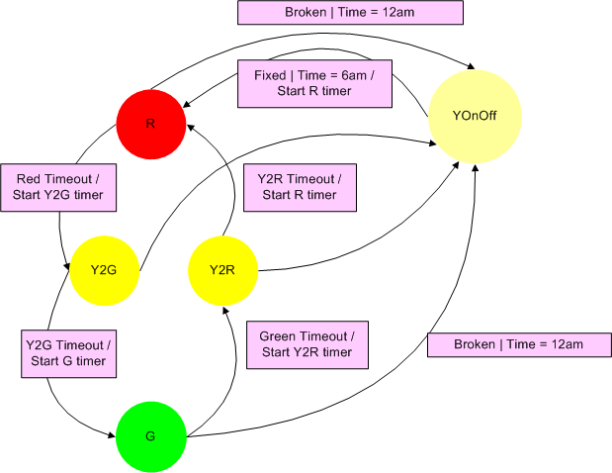
State Transition Testing example – traffic light
Notes:
lists all possible state-transition combinations

Slide 36
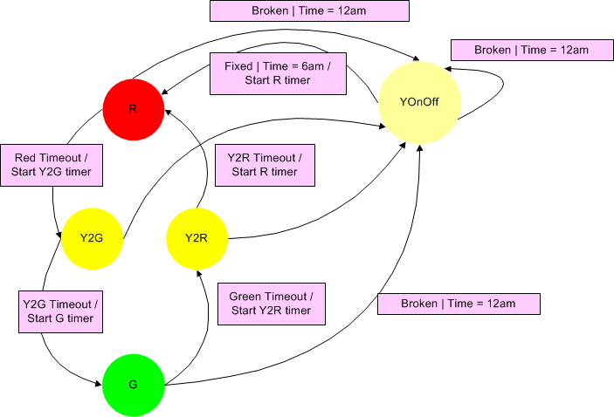
State Transition Testing example – traffic light
Notes:
lists all possible state-transition combinations

Slide 37
State Transition Testing example – traffic light
Adjacency Matrix [A]
New State → Current State ↓ | R | Y2G | G | Y2R | YOnOff
R | 0 | 1 | 0 | 0 | 2
Y2G | 0 | 0 | 1 | 0 | 2
G | 0 | 0 | 0 | 1 | 2
Y2R | 1 | 0 | 0 | 0 | 2
YOnOff | 2 | 0 | 0 | 0 | 2
Sum of the cell values: 16
=> Maximum 16 tests to cover all 1-step transitions
[A]² = number of all 2-step transitions (=58). [A]³ … etc.
Notes:
[A]^2”:
R Y2G G Y2R YOnOff
R 4 0 1 0 6
Y2G 4 0 0 1 6
G 5 0 0 0 6
Y2R 4 1 0 0 6
YOnOff 2 2 0 0 8

Slide 38
State Transition Testing example – traffic light
State transition Table
New State → Current State ↓ | R | Y2G | G | Y2R | YOnOff
R |  | Red Timeout / Yellow ON |  |  | Broken | 12am / Red OFF Flashing Yellow ON
Y2G |  |  | Y2G Timeout / Red & Yellow OFF, Green ON |  | Broken | 12am / Flashing Yellow ON
G |  |  |  | Green Timeout / Green OFF; Yellow ON | Broken | 12am / Green OFF Flashing Yellow ON
Y2R | Y2R Timeout / Yellow OFF Red ON |  |  |  | Broken | 12am / Flashing Yellow ON
YOnOff | Fixed | 6am / Yellow OFF Red ON |  |  |  | Broken | 12am / Flashing Yellow ON
Notes:
lists all possible state-transition combinations

Slide 39
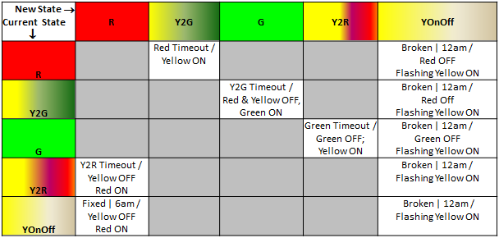
State Transition Testing example – traffic light
Adjacency Matrix
New State → Current State ↓ | R | Y2G | G | Y2R | YOnOff
R | 0 | 1 | 0 | 0 | 2
Y2G | 0 | 0 | 1 | 0 | 2
G | 0 | 0 | 0 | 1 | 2
Y2R | 1 | 0 | 0 | 0 | 2
YOnOff | 2 | 0 | 0 | 0 | 2
Tests (all 1-step transitions)
Test | Start state | Input | Expected Result
1 | R | Red Timeout | Red & Yellow turns on
2 | R | Broken | Red turns off; Yellow is flashing
3 | R | Time = 12am | Red turns off; Yellow is flashing
4 | Y2G | Y2G Timeout | Red & Yellow turns off; Green turns on
5 | Y2G | Broken | Red turns off; Yellow is flashing
6 | Y2G | Time = 12am | Red turns off; Yellow is flashing
7 | G | Green Timeout | Green turns off; Yellow turns on
8 | G | Broken | Green turns off; Yellow is flashing
9 | G | Time = 12am | Green turns off; Yellow is flashing
10 | Y2R | Y2R Timeout | Yellow turns off; Red turns on
11 | Y2R | Broken | Yellow is flashing
12 | Y2R | Time = 12am | Yellow is flashing
13 | YOnOff | Fixed | Yellow turns off; Red turns on
14 | YOnOff | Time = 6am | Yellow turns off; Red turns on
15 | YOnOff | Broken before 6am | Yellow flashing (even after 6am)
16 | YOnOff | Time = 12am | Yellow flashing (even after fixed)
Note: 16 tests to cover all 1-step paths ( = sum of cells)
State transition Table
Notes:
lists all possible state-transition combinations
14/May/25: I had this in the slide:
Notes: “Broken” & “Fixed” – may add many more tests!
But I don’t understand what I meant so I removed it.

Slide 40
State Transition Testing
Minimum coverage goal:
All states
All transitions
All inputs
All 1-step transition (“0-switch coverage”)
Number of tests increase exponentially when going to 2-step, 3-step etc.
Apply system knowledge to select specific n-step paths
In our example:
12am –> 6am 2-path is an interesting path (will it indeed return always to Red? Perhaps it remember where it was at 12am?)
Notes:
lists all possible state-transition combinations

Slide 41
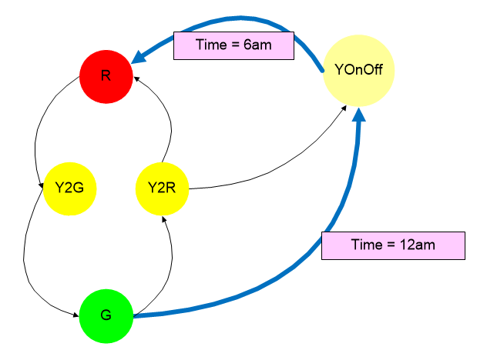
Testability hooks
How much time does it take to test this path?

Slide 42
Testability hooks
This will help:
setTime(time);
In some cases, testing without a testability hooks is infeasible
In other cases, a proper hook can significantly simplify or shorten testing

Slide 43
Class Activity

Slide 44
Class activity
Draw the state diagram for trace_it
Load your diagram to Moodle
20 minutes
Notes:
To monitor progress, run 02-01-040_API comments monitor.bat
Full path:
"D:\OneDrive - ITCB\Documents\Training\SW Testing\Azrieli\2027\Lesson 02 - Reviews, Static testing and Static analysis\01 Class activity\02-01 API review\02-01-040_API comments monitor.bat"

Slide 45
Summary
Black box techniques
Equivalence Class
Boundary Values
Decision Table
State Transition

Slide 46
Resources & References – Combinatorial testing
https://www.pairwise.org
Articles, Resources, Tools list
[Tatsumi]: Test Case Design Support System https://www.researchgate.net/publication/255983189_Test_Case_Design_Support_System
[Cohen at al.] The AETG System: An Approach to Testing Based on Combinatorial Design https://ix.cs.uoregon.edu/~michal/Classes/f99/cis610sqa/Readings/cohen-AETG.pdf
[Miller]: Miller, G.A. (1956): The magical number seven, plus or minus two, Psychological Review 63:2, p. 81-97. https://labs.la.utexas.edu/gilden/files/2016/04/MagicNumberSeven-Miller1956.pdf
Pairwise Testing in the Real World: Practical Extensions to Test-Case Scenarios http://msdn.microsoft.com/en-us/library/cc150619.aspx
[Bach, Shroeder]: Bach, J., and P. Shroeder. “Pairwise Testing: A Best Practice that Isn’t.” https://www.satisfice.us/articles/pairwise.pdf

Slide 47
CREDITS
Special thanks to all the people who made and released these awesome resources for free:
Presentation template by SlidesCarnival
Photographs by Unsplash

